Slide 1
VAE and Variance
Presenter: Kim Seung Hwan (overnap@khu.ac.kr)

Slide 2
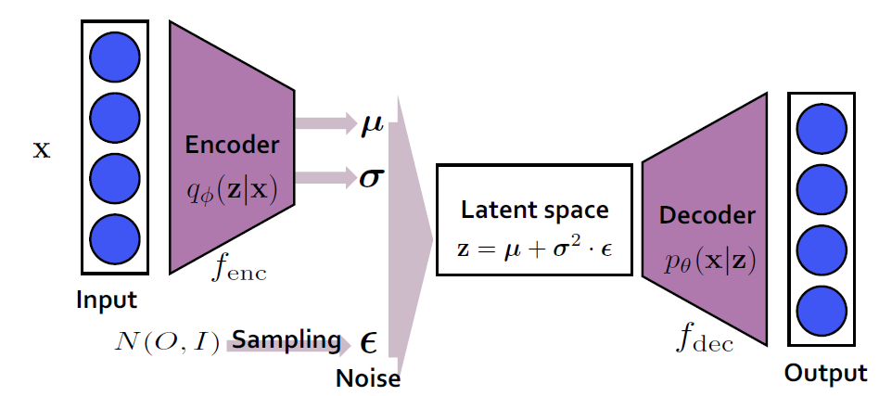
VAE Architecture (recall)
The encoder inferences the mean and variance in the latent space of a sample
From its (estimated) latent distribution, Decoder reconstruct the sample
The latent space is set to a prior (e.g. normal or uniform)
So the decoder can generate samples

Slide 3
ELBO (recall)
It is optimized by ELBO (Evidence Lower Bound)
ELBO consists of the reconstruction term and regularization term
Since ELBO is the bound of the negative log-likelihood,
VAE is viewed as a deep maximum likelihood model

Slide 4
Don’t blame the ELBO
ELBO has been blamed for many of the issues the VAE has
Numerous studies claim the term-balance problem of ELBO
Or/and the problem of the term itself
But the local maxima issue also occurs exact log-likelihood optimization:
“Unexpectedly, we show that spurious local maxima may arise even in the optimization of exact marginal likelihood, and such local maxima are linked with a collapsed posterior”
Lucas, James, et al. "Don't blame the elbo! a linear vae perspective on posterior collapse." Advances in Neural Information Processing Systems 32 (2019).

Slide 5
Blame the Encoder
I think ELBO is both mathematically and intuitively correct
If there is enough sampling(i.e. training data), ELBO can estimate the distribution
I pay attention to the implementation of a VAE

Slide 6
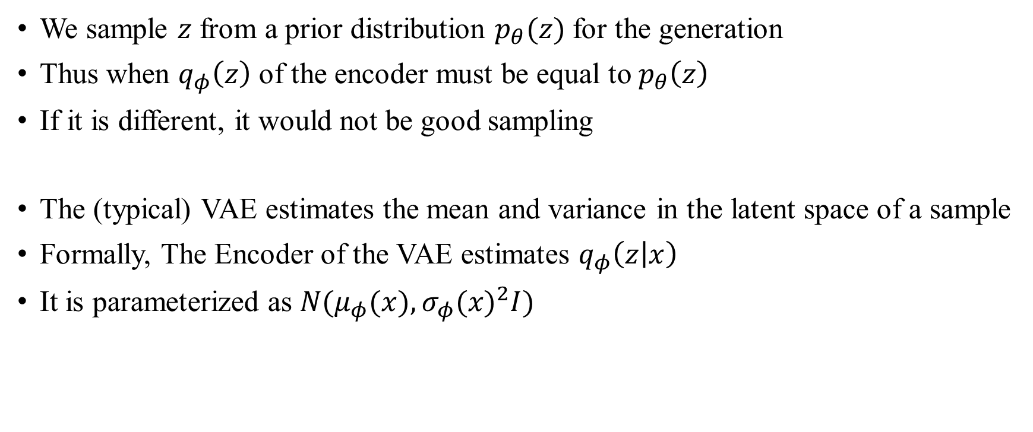
Blame the Encoder (contd.)
We sample $z$ from a prior distribution $p_{θ}(z)$ for the generation
Thus when $q_{φ}\left(z\right)$ of the encoder must be equal to $p_{θ}\left(z\right)$
If it is different, it would not be good sampling
The (typical) VAE estimates the mean and variance in the latent space of a sample
Formally, The Encoder of the VAE estimates $q_{φ}\left(z | x\right)$
It is parameterized as $N(μ_{φ}(x), {σ_{φ}(x)}^{2}I)$

Slide 7
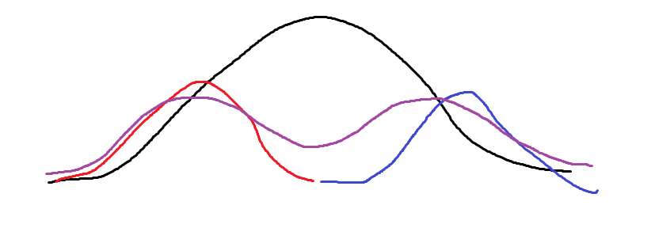


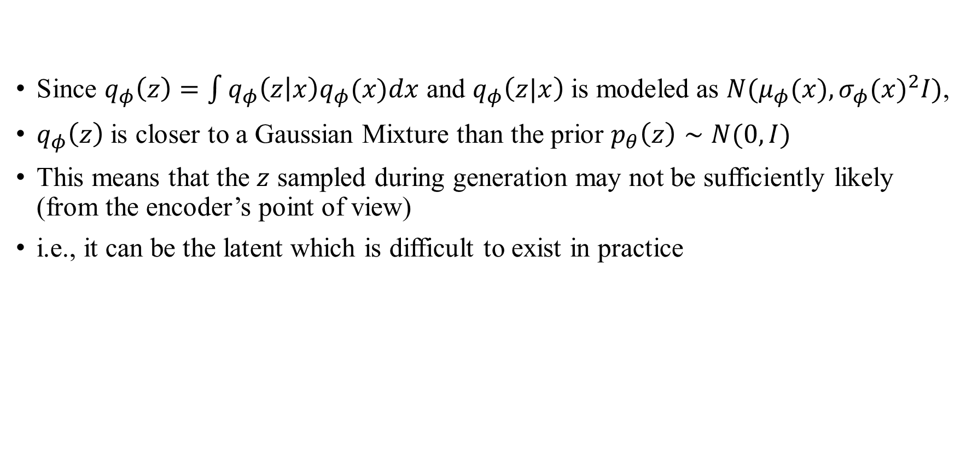


Blame the Encoder (contd.)
Since $q_{φ}\left(z\right)=\int{q_{φ}\left(z | x\right)q_{φ}(x)dx}$ and $q_{φ}\left(z|x\right)$ is modeled as $N(μ_{φ}(x), {σ_{φ}(x)}^{2}I)$,
$q_{φ}\left(z\right)$ is closer to a Gaussian Mixture than the prior $p_{θ}\left(z\right)∼N(0,I)$
This means that the $z$ sampled during generation may not be sufficiently likely (from the encoder’s point of view)
i.e., it can be the latent which is difficult to exist in practice
Prior $p_{θ}(z)$
$$q_{φ}(z|x_{1})$$
Very unlikely point
(but often sampled)
$$q_{φ}(z|x_{2})$$
$$q_{φ}(z)$$

Slide 8

Blame the Encoder (contd.)
Therefore, rather than modifying ELBO as before,
The divergence of $q_{φ}(z)$ and $p_{θ}(z)$ should be added to the loss
It seems very difficult…
Prior $p_{θ}(z)$
$$q_{φ}(z|x_{1})$$
Very unlikely point
(but often sampled)
$$q_{φ}(z|x_{2})$$
$$q_{φ}(z)$$

Slide 9
Alternative Approach
The decoder is usually implemented as deterministic
At another perspective, the generated one can be thought as “the mean point” that would result from the sampled latent
This is why VAEs with deterministic decoders are blurred,
While probabilistic decoders are noisy
Prior $p_{θ}(z)$
$$q_{φ}(z|x_{1})$$
Very unlikely point
(but often sampled)
$$q_{φ}(z|x_{2})$$
$$q_{φ}(z)$$

Slide 10
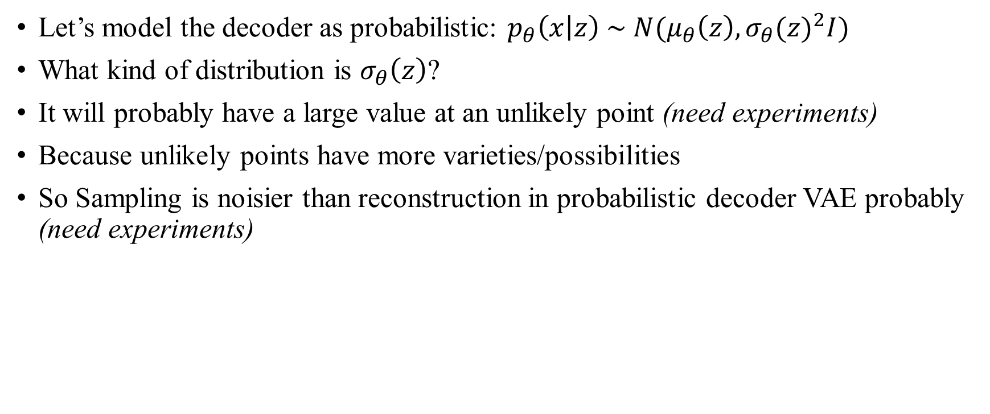
Alternative Approach (contd.)
Let’s model the decoder as probabilistic: $p_{θ}\left(x | z\right) \sim N(μ_{θ}\left(z\right), {σ_{θ}(z)}^{2}I)$
What kind of distribution is $σ_{θ}\left(z\right)$?
It will probably have a large value at an unlikely point (need experiments)
Because unlikely points have more varieties/possibilities
So Sampling is noisier than reconstruction in probabilistic decoder VAE probably (need experiments)
Prior $p_{θ}(z)$
$$q_{φ}(z|x_{1})$$
Very unlikely point
(but often sampled)
$$q_{φ}(z|x_{2})$$
$$q_{φ}(z)$$

Slide 11
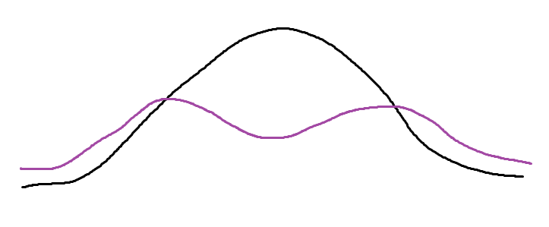
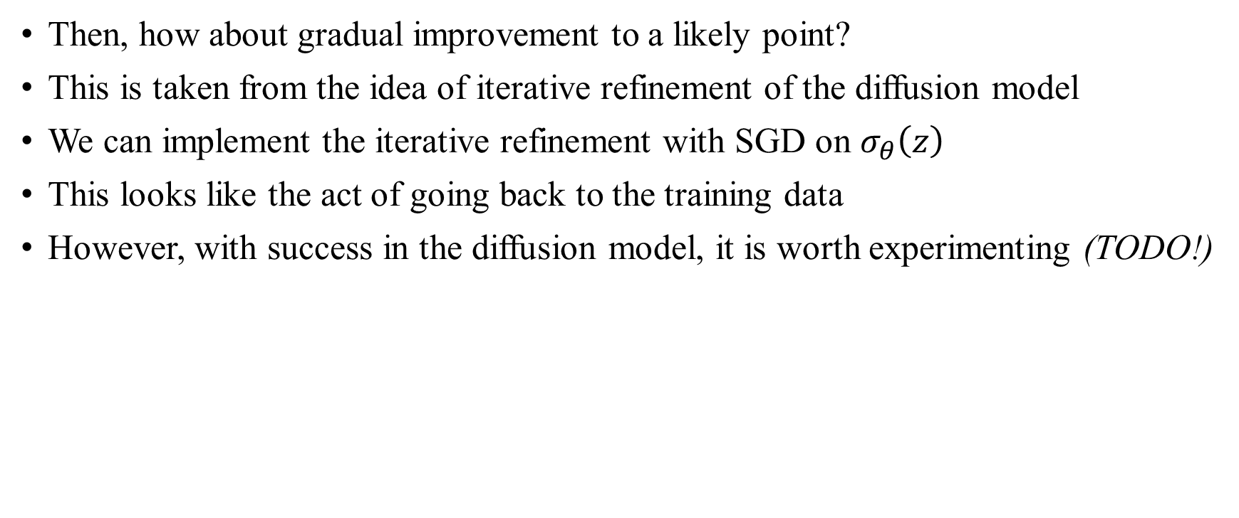


Alternative Approach (contd.)
Then, how about gradual improvement to a likely point?
This is taken from the idea of iterative refinement of the diffusion model
We can implement the iterative refinement with SGD on $σ_{θ}\left(z\right)$
This looks like the act of going back to the training data
However, with success in the diffusion model, it is worth experimenting (TODO!)
Prior $p_{θ}(z)$
Very unlikely point
(but often sampled)
$$q_{φ}(z)$$

Slide 12
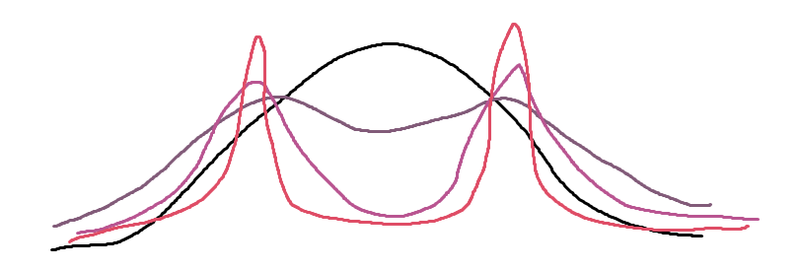

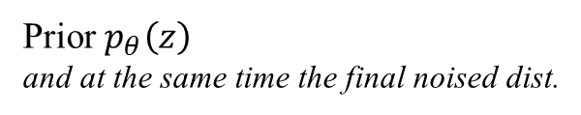

Alternative Approach (contd.)
Note the difference with the diffusion model
Diffusion is performed on data (and its gradual noised) distributions
Whereas VAE operates on the latent (but 1-step various noised) distribution
Diffusion directly approximates the score, the gradient-log of the distribution
While VAE only knows the variance, the proxy for likelihood
Diffusion Model
VAE
Prior $p_{θ}\left(z\right)$
and at the same time the final noised dist.
in noised data space
in latent space
Prior $p_{θ}(z)$
Very unlikely point
(but often sampled)
Very unlikely point
(but often sampled)
$$q_{φ}(z)$$
The redder the line, the lighter the noise

Slide 13

Expected Problems
$σ_{θ}(z)$ is going to be smaller at the likely point (this helps improve loss)
But is $σ_{θ}(z)$ bigger at the unlikely point?
Looks like some mathematical proof or additional loss is needed
Prior $p_{θ}(z)$
$$q_{φ}(z|x_{1})$$
Very unlikely point
(but often sampled)
$$q_{φ}(z|x_{2})$$
$$q_{φ}(z)$$

Slide 14

Expected Problems (contd.)
VAE is good for logically clean normal-sampling with variational inference
Refinement of the latent $z$ means making a sampling method
It is just like a different structure than ordinary VAE
Would not this dilute the advantage of VAE?
Why not just use diffusion?
Diffusion Model
VAE
Prior $p_{θ}\left(z\right)$
and at the same time the final noised dist.
in noised data space
in latent space
Prior $p_{θ}(z)$
Very unlikely point
(but often sampled)
Very unlikely point
(but often sampled)
$$q_{φ}(z)$$
The redder the line, the lighter the noise

Slide 15

Expected Problems (contd.)
$σ_{θ}(z)$ means the expected variance in the data distribution $p_{θ}(x)$
Output $x$ has very large dimension compared to the input $z$
Can this be optimized well?
Prior $p_{θ}(z)$
$$q_{φ}(z|x_{1})$$
Very unlikely point
(but often sampled)
$$q_{φ}(z|x_{2})$$
$$q_{φ}(z)$$

Slide 16

Other Discussions
I thought the variance of an encoder’s output (i.e. $σ_{φ}^{2}(x)$ of $q_{θ}(z|x)$) was:
“How common a sample is in that feature channel”
But “common” is more like having a small average (i.e. $μ_{φ}(x)≈0$) exactly
What does the variance mean?!

Slide 17
Other Discussions (contd.)
In the first place, is the variance an important information to reconstruct/sampling?
Already only diagonal covariance are assumed in VAE in general
So each channel in the latent space is independent
This is very strong assumption, but VAE works quite well...

Slide 18
Other Discussions (contd.)
Theoretically, VAE with isotropic variance can represent any normalizing flow model (the computational cost for optimization is inefficient though)
What if we just removed the degrees-of-freedom of the variance?
Maybe we can manually set the variance per channel
If we put it in gradual variance, can we get the benefit of the gradual noise we took in diffusion model? (very naïve idea)

Slide 19
Schedule and Plan
Siggraph asia 2023 poster Submission Deadline: 14 August 2023, 23:59 AoE
The deadline is very tight, and (light) VAE is very fast to experiment with
Plan to finish all implementation and initial experiments within June (~next week)
If the results are not promising…
Somehow produce ideas related to VAE or diffusion
Even if it is a bad topic, the goal is to write a paper as an experience

Slide 20
Schedule and Plan (contd.)
If the results are good,
Continue the experiment and write a poster in July
And have to go through the previous research very meticulously

Slide 21
Thank you for listening
Presenter: Kim Seung Hwan (overnap@khu.ac.kr)

